Slide 1
Create a DFD for a hospital management system.

Slide 2
Level 0 — Context diagram (the big picture) This is the simplest view. The entire hospital system is one circle in the middle. Outside it are all the people and systems that interact with it (called "external entities"). Arrows show what data passes between them.

Slide 3
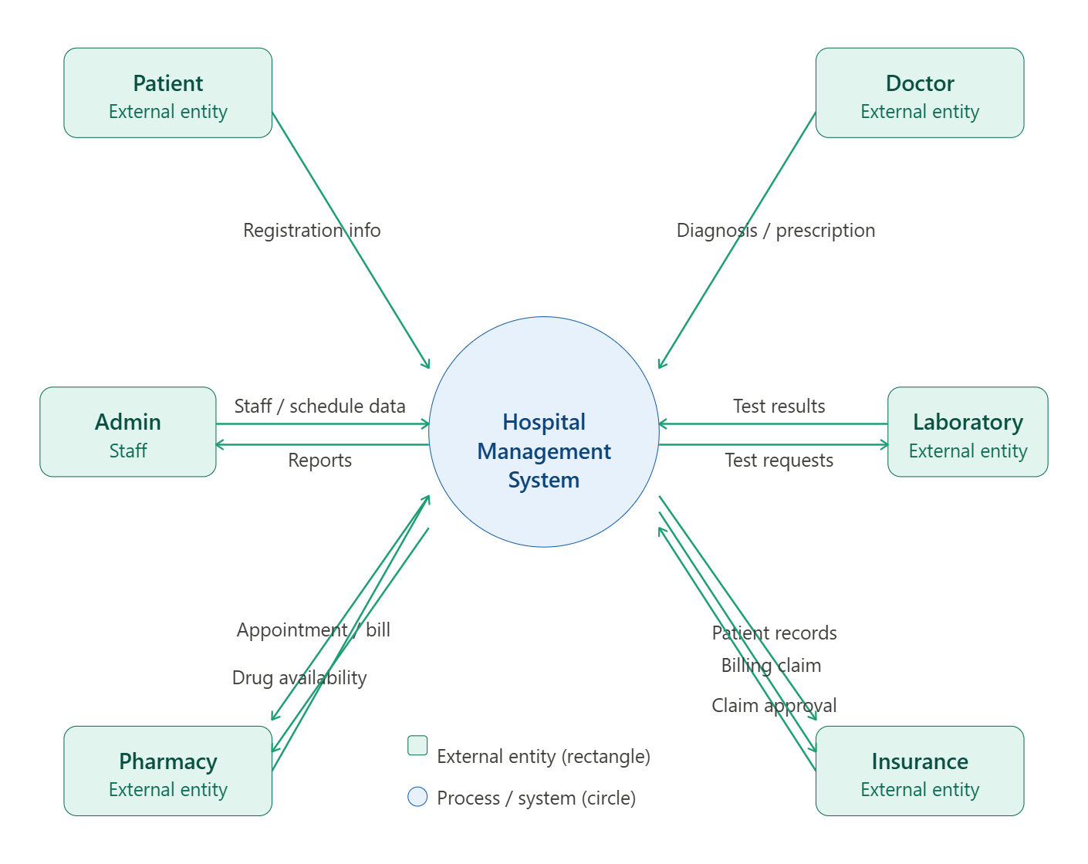

Slide 4
What you're looking at: The blue circle is the entire hospital system treated as one "black box". The green rectangles are everyone who interacts with it from the outside. Arrows show the flow of information — for example, a Patient sends "registration info" in, and gets back an "appointment/bill". You can click any box to learn more.
Level 1 — Detailed DFD (inside the system)
Now we "zoom in" to the blue circle and show the 5 major processes happening inside, plus the data stores (where information is saved). This is the heart of the DFD.

Slide 5
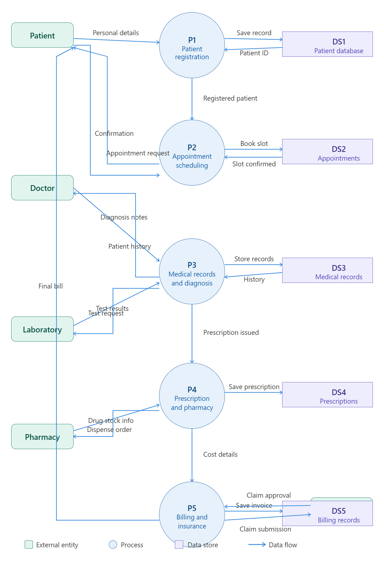

Slide 6
How to read a DFD — key concepts
External entities (green rectangles) — people or systems outside the hospital. They are the sources and destinations of data: Patient, Doctor, Lab, Pharmacy, Insurance.
Processes (blue circles) — actions the system performs on data. Each process transforms input data into output data:
P1 — Patient registration: collects personal details, creates a patient record
P2 — Appointment scheduling: books a time slot for a patient-doctor meeting
P3 — Medical records & diagnosis: the doctor records diagnosis; links to lab test requests and results
P4 — Prescription & pharmacy: issues prescriptions; notifies pharmacy to dispense drugs
P5 — Billing & insurance: calculates the total cost and sends a claim to insurance
Data stores (purple open rectangles) — databases where information is saved and retrieved:
DS1 — Patient database (names, IDs, contact details)
DS2 — Appointments (dates, times, doctor assignments)
DS3 — Medical records (diagnoses, treatment history)
DS4 — Prescriptions (medicines, dosages)
DS5 — Billing records (invoices, payments)
Data flows (blue arrows) — lines showing what information travels between entities, processes, and stores. The arrow direction tells you which way the data moves. For example, "Personal details" flows from the Patient into P1, and "Final bill" flows back out to the Patient after P5.

Slide 7
What data does a doctor interact with in a hospital system?
A doctor interacts with several categories of data across the full patient care cycle:
Patient information The starting point is always the patient record — demographic details (name, age, contact), medical history, allergies, previous diagnoses, and past medications. This context is essential before any consultation.
Appointments & scheduling Doctors see their daily/weekly schedule, including which patients are assigned to them, consultation times, and any follow-up visit requests.
Clinical / diagnostic data This is the core of a doctor's work:
Symptoms and chief complaints recorded during a visit
Physical examination findings they enter into the system
Vital signs (blood pressure, temperature, heart rate, etc.)
Lab test results (blood panels, urine analysis, cultures, etc.)
Radiology and imaging reports (X-rays, MRI, CT scans)

Slide 8
Diagnoses & treatment plans Doctors write and read diagnosis codes (often ICD codes in real systems), treatment plans, clinical notes, and follow-up instructions. They may update a patient's condition status as treatment progresses.
Prescriptions Doctors create prescriptions — specifying the drug name, dosage, frequency, and duration. The system may also show them drug interaction warnings or allergy alerts before they finalise a prescription.
Lab & test orders Doctors request diagnostic tests (e.g. "order a CBC blood test") and later retrieve the results. The data flows both ways — orders go out, results come back.
Referrals When a doctor refers a patient to a specialist, they interact with referral data — the reason for referral, the receiving doctor, and the urgency level.
Billing codes In many systems, doctors attach procedure codes (CPT codes) to their consultations, which feed directly into the billing process. They don't manage billing themselves, but their entries trigger it.
In summary, a doctor primarily reads patient history and test results, and writes diagnoses, prescriptions, test orders, and clinical notes — all of which then ripple outward to the pharmacy, laboratory, and billing departments

